Slide 1
Attorney Billing
Oracle Application Walkthrough

Slide 2
When will the app launch?
Friday, March 1st 2024

Slide 3
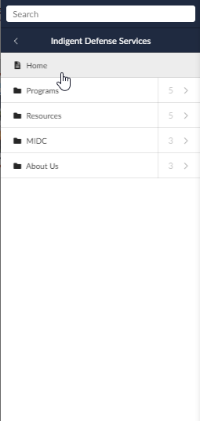
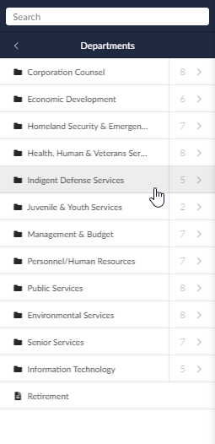
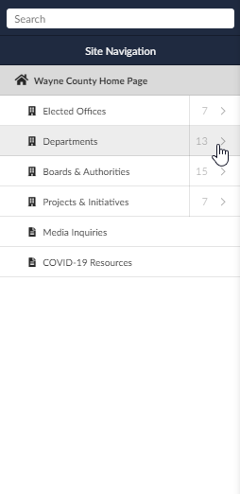
Where can I find the app?
https://www.waynecounty.com/departments/ids/home.aspx
Works on mobile!

Slide 4
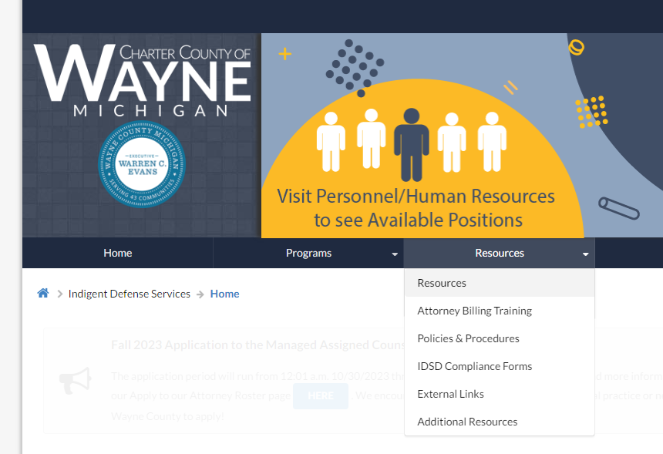
Where can I find help?
https://www.waynecounty.com/departments/ids/attorney-billing-training.aspx

Slide 5
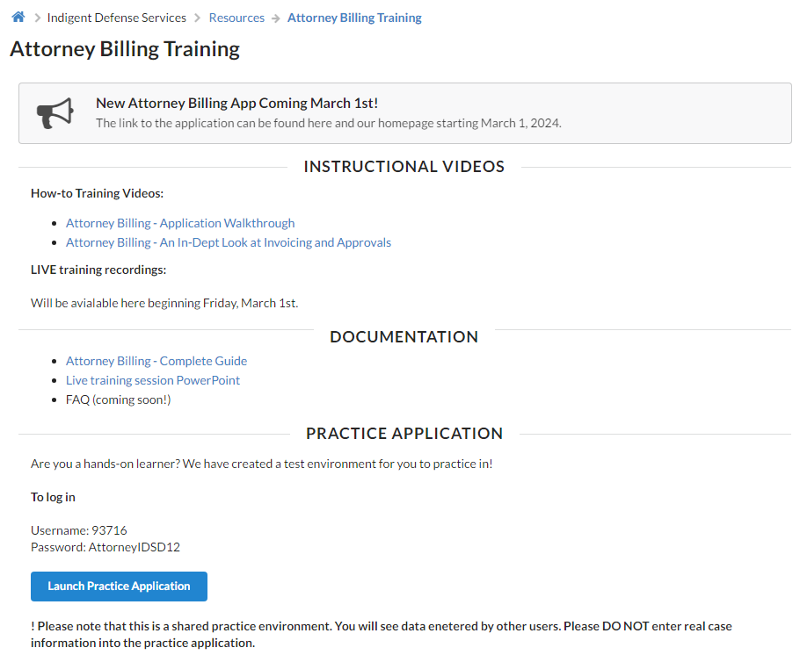
Where can I find help?
Videos
Documentation
Live Training Recordings
Practice Application
https://www.waynecounty.com/departments/ids/attorney-billing-training.aspx

Slide 6
Today’s Session
Logging in
Password Reset
Attorney Dashboard
Creating a Billing Item
Attaching Documentation
Editing a Billing Item

Slide 7
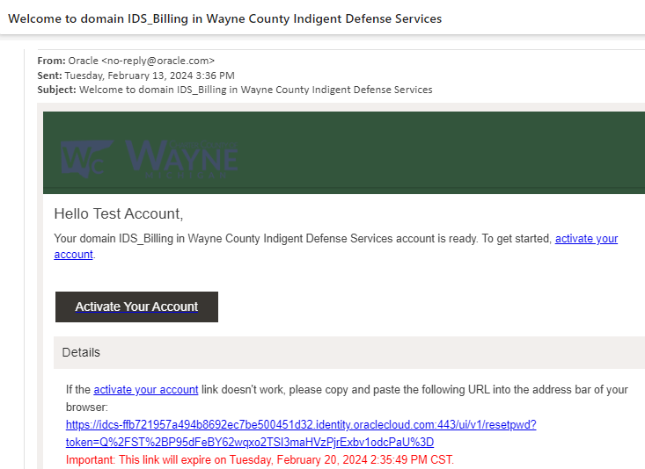
Activating Your Account
Activation emails sent out Friday, March 1st
From: no-reply@oracle.com
Links expire after 7 days
If you require a new activation link please contact: IDSDIT@waynecountymi.gov

Slide 8
Today’s Session
Logging in
Password Reset
Attorney Dashboard
Creating a Billing Item
Attaching Documentation
Editing a Billing Item

Slide 9
Today’s Session
Logging in
Password Reset
Attorney Dashboard
Creating a Billing Item
Attaching Documentation
Editing a Billing Item

Slide 10
Today’s Session
Logging in
Password Reset
Attorney Dashboard
Creating a Billing Item
Attaching Documentation
Editing a Billing Item

Slide 11
Today’s Session
Logging in
Password Reset
Attorney Dashboard
Creating a Billing Item
Attaching Documentation
Editing a Billing Item

Slide 12
Today’s Session
Logging in
Password Reset
Attorney Dashboard
Creating a Billing Item
Attaching Documentation
Editing a Billing Item

Slide 13
Next Week
Creating an Invoice
Attaching Billing Items
The Approval Process

Slide 14
Thank you
For technological questions surrounding the application, please contact our IT team at IDSDIT@waynecountymi.gov
For policy questions surrounding payment and billing activities, please contact IDSDWayne@waynecountymi.gov or IDSDAttorney@waynecountymi.gov
For questions about updating your w-9, billing address, or electronic payment account information, please contact IDSDFinance@waynecountymi.gov

